Slide 1
Blockchain Technology
Prepared by: Dr. Reema patel

Slide 2
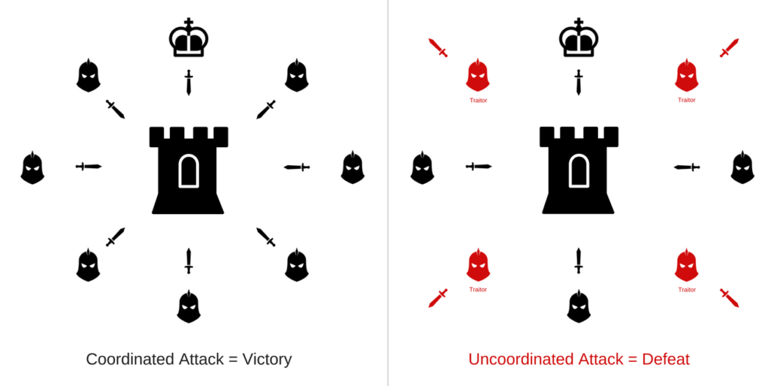
Byzantine Generals Problem
Several divisions of the Byzantine army are camped outside an enemy city, each division commanded by its own general.
The generals can communicate with one another only by messenger.
After observing the enemy, they must decide upon a common plan of action
Generals should reach a consensus on the plan
It could be ATTACK or RETREAT

Slide 3
Byzantine Generals Problem
But there might be traitors - traitors can act arbitrarily
All loyal generals should reach a consensus
IC1. All loyal lieutenants obey the same order
IC2. If the commanding general is loyal, then every loyal lieutenant obeys the order he sends.
Consistency/Agreement
Validity
Liveness/Termination?

Slide 4
Byzantine Generals Problem
Consistency Broken

Slide 5
Byzantine Generals Problem
The Byzantine Generals Problem will fail
If: 1/3 or more of the generals are traitors.
No solution for:
Fewer than 3m + 1 generals; m = number of traitor generals

Slide 6
Byzantine Generals Problem
if the generals can send only oral messages, then no solution will work unless more than ⅔ of the generals are loyal.”
oral messages:
every message that is sent is delivered correctly
the receiver of a message knows who sent it – authentication channel
the absence of a message can be detected – synchronous network

Slide 7
Byzantine Generals Problem
With only oral messages, traitors can lie by telling the wrong command they received
Signed messages
cannot be forged
anyone can verify the authenticity

Slide 8
Thoughts
Defined Byzantine generals problem
Proved lower bound in synchronous environment with authenticated channel
Introduced solutions in synchronous environment with authenticated channel and with digital signature
But today we usually discuss about the case when in partial
synchronous/asynchronous environment with digital signature where PBFT works

Slide 9
Timeline

Slide 10
Decentralized applications
The most revolutionary and controversial manifestation of Ethereum is the self governing and decentralized application (DApp).
DApp are applications that are open source, not controlled by one person or entity and run across a distributed blockchain or network of computers.
DApps can manage things like digital assets and DAOs.
DApps were created to replace centralized management of assets and organizations.

Slide 11
Decentralized applications
Dapps, DAOs, DACs, and DASs are abbreviated terms for decentralized applications,
decentralized autonomous organizations, decentralized autonomous corporations, and decentralized autonomous societies, respectively.
Essentially this group connotes a potential progression
to increasingly complex and automated smart contracts that become more like self-contained entities,
conducting preprogrammed and eventually self-programmed operations linked to a blockchain.

Slide 12
Decentralized applications
DAOs/DACs (decentralized autonomous organizations/corporations) are a concept derived from artificial intelligence.
A decentralized network of autonomous agents perform tasks,
which can be conceived in the model of a corporation running without any human involvement under the control of a set of business rules.
In a DAO/DAC, there are smart contracts as agents running on blockchains that execute ranges of pre-specified or preapproved tasks based on events and changing conditions

Slide 13
Decentralized applications
Here’s how DAOs basically work:
A group of people writes a smart contract to govern the organization.
People add funds to the DAO and are given tokens that represent ownership.
This structure works kind of like stock in a company, but the members have control of the funds from day one.
When the funds have been raised, the DAO begins to operate by having members propose how to spend the money.
The members vote on these proposals.
When the predetermined time has passed and the predetermined number of votes has accrued, the proposal passes or fails.
Individuals act as contractors to service the DAO.

Slide 14
Decentralized applications
Unlike most traditional investment vehicles,
where a central party makes decisions about investments,
the members of a DAO control 100 percent of the assets.
They vote on new investments and other decisions.
This type of structure threatens to displace traditional financial managers.

Slide 15
Smart Contracts
A contract in the traditional sense is an agreement between two or more parties to do or not do something in exchange for something else.
Each party must trust the other party to fulfill its side of the obligation.
Smart contracts feature the same kind of agreement to act or not act, but they remove the need for one type of trust between parties.
Smart contract is both defined by the code and executed (or enforced) by the code, automatically without discretion.
In fact, three elements of smart contracts that make them distinct are autonomy, self-sufficiency, and decentralization.

Slide 16
Smart Contracts
Autonomy means
after it is launched and running,
a contract and its initiating agent need not be in further contact.
Second, smart contracts might be self-sufficient in their ability to marshal resources
raising funds by providing services or issuing equity, and
spending them on needed resources, such as processing power or storage.
Third, smart contracts are decentralized
they do not subsist on a single centralized server;
they are distributed and self-executing across network nodes

Slide 17
Smart Contracts
Smart contracts are contracts that are written in computer code and operate on a blockchain or distributed ledger
They automatically verify, execute, and enforce the contract based on the terms written in the code
Smart contracts can be partially or fully self-executing and self-enforcing
Run on the blockchain and operates automatically
If conditions of a contract are met, payments or value are exchanged based on the terms of the contract
Smart contracts on blockchain removing risks around unauthorized changes, fraud, server failure or non-compliance with the terms of the contract

Slide 18
Smart contracts can automatize execution of transactions

Slide 19
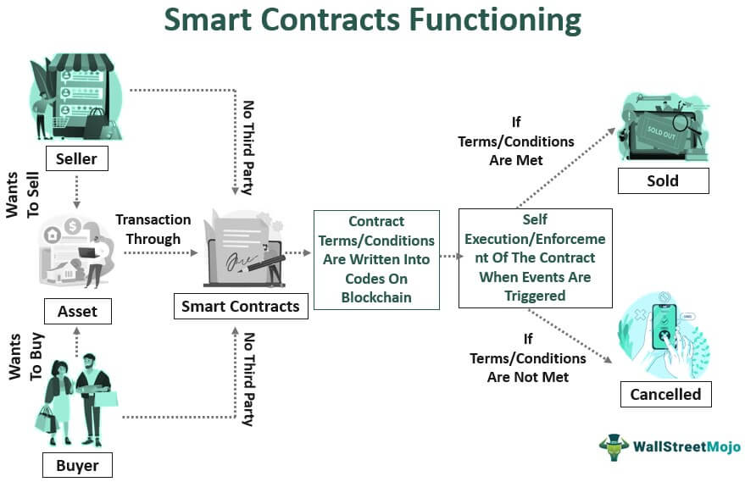
Smart Contracts

Slide 20
Blockchain Revolution

Slide 21
Smart contracts - Ethereum
Ethereum smart contracts are like contractual agreements, except there is no central party to enforce the contract.
They can also enforce implementation of a requirement if it lives within Ethereum,
because Ethereum can prove certain conditions were or were not met.
If it doesn’t live within Ethereum, it’s much harder to enforce.
Ethereum smart contracts do not include artificial intelligence.
This is a possibility in the near future.

Slide 22
Smart contracts - Ethereum
A smart contract is a code that runs on the EVM
Smart contracts can accept and store ether, data, or a combination of both
Using the logic programmed into the contract,
It can distribute the ether to other accounts or even other smart contracts
Example:
Alice wants to hire bob to build her a bakery
They are using an escrow contract (a place to store money until a condition is fulfilled) to store their ether before the final transaction

Slide 23
Smart contracts - Ethereum

Slide 24
Smart contracts - Ethereum

Slide 25
Example

Slide 26
Example
Ledger
At the simplest level, a blockchain immutably records transactions which update states in a ledger.
A smart contract programmatically accesses two distinct pieces of the ledger – a blockchain, which immutably records the history of all transactions, and a world state that holds a cache of the current value of these states, as it’s the current value of an object that is usually required.
Smart contracts primarily put, get and delete states in the world state, and can also query the immutable blockchain record of transactions.
A get typically represents a query to retrieve information about the current state of a business object.
A put typically creates a new business object or modifies an existing one in the ledger world state.
A delete typically represents the removal of a business object from the current state of the ledger, but not its history.

Slide 27
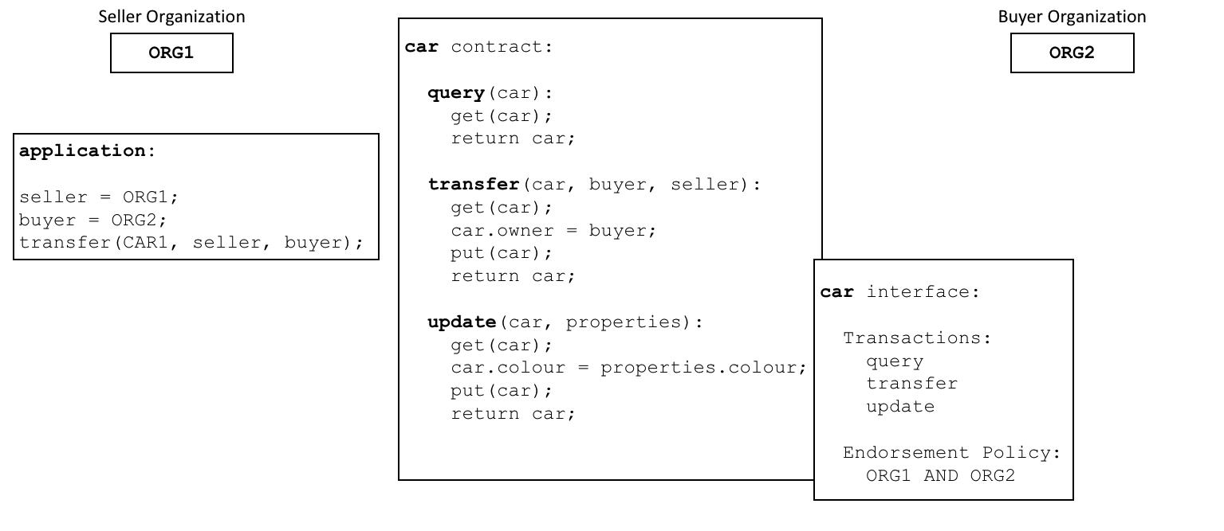
Example
Endorsement

Slide 28
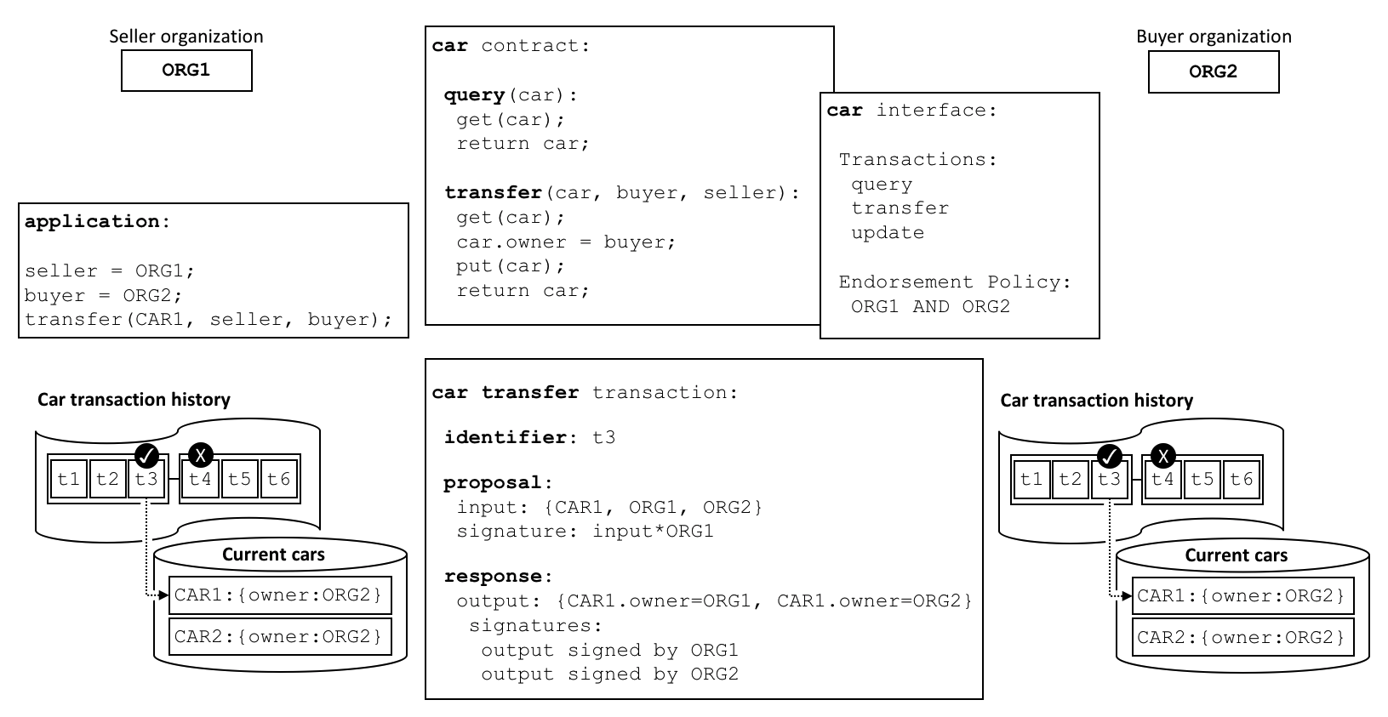
Example
Valid transactions

Slide 29
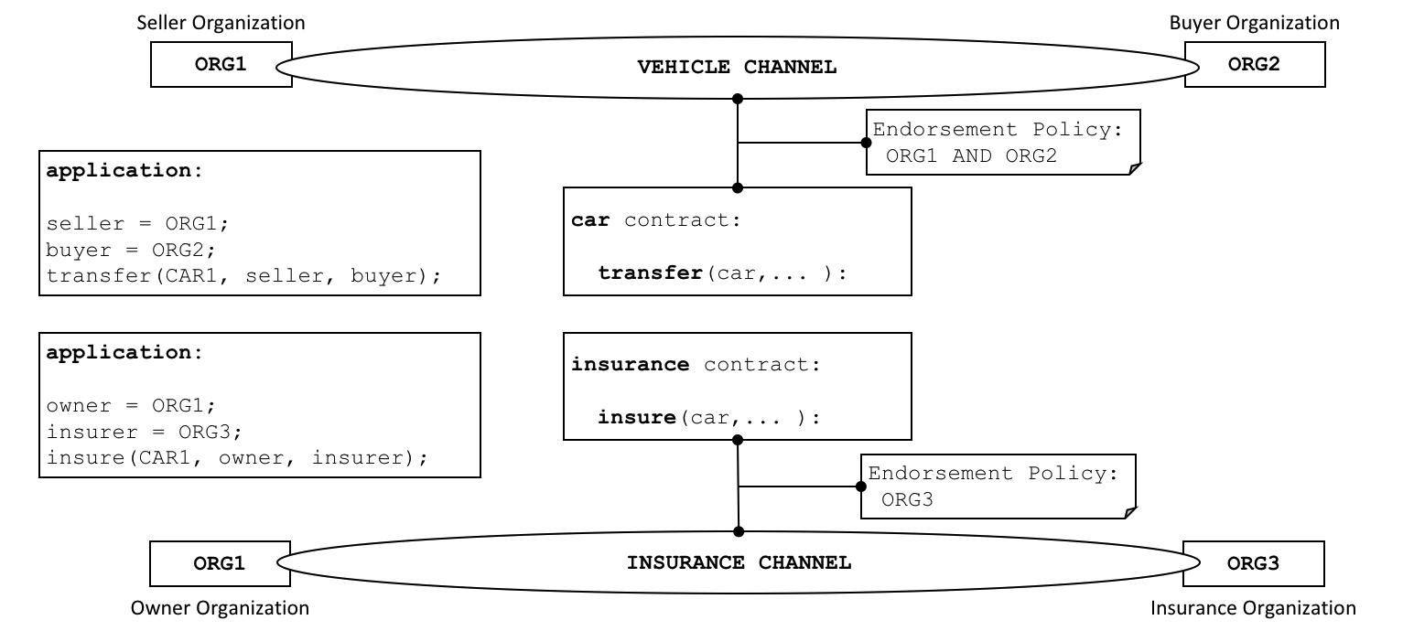
Example

Slide 30
Deterministic Smart Contract
Smart contract can be divided into deterministic and non-deterministic smart contracts.
Deterministic smart contracts are smart contract codes that do not depend on outside information other than information on the Blockchain in which they live in to be triggered and work effectively.
In other words, the Blockchain network facilitating the smart contract has sufficient information to make decisions.
E.g.,
peer-to-peer lottery: the funds are held on the Blockchain network and random numbers are also generated by the smart contract code.
At the end of the lottery, the funds are transferred the winners account via his or her address on the Blockchain network

Slide 31
Non-Deterministic Smart Contracts

Slide 32
Decentralized Application (Dapp)
Dapp is an application that uses smart contracts.
Dapp provides a user-friendly interface to smart contracts
Dapp main components are smart contract and files for web user interface front-end/back-end

Slide 33
DappCreation Workflow

Slide 34
Blockchain Forks
Because the blockchain is a decentralized data structure, different copies of it are not always consistent.
Blocks might arrive at different nodes at different times, causing the nodes to have different perspectives of the blockchain.
To resolve this, each node always selects and attempts to extend the chain of blocks that represents the most proof of work, also known as the longest chain or greatest cumulative difficulty chain.
By summing the difficulty recorded in each block in a chain, a node can calculate the total amount of proof of work that has been expended to create that chain.
As long as all nodes select the longest cumulative difficulty chain, the global bitcoin network eventually converges to a consistent state.
Forks occur as temporary inconsistencies between versions of the blockchain, which are resolved by eventual reconvergence as more blocks are added to one of the forks.

Slide 35
Blockchain Forks
In reality, the bitcoin network’s topology is not organized geographically.
it forms a mesh network of interconnected nodes, which might be located very far from each other geographically.
In the bitcoin network, the “distance” between nodes is measured in “hops” from node to node, not on their physical location.

Slide 36
Visualization of a blockchain fork event—before the fork

Slide 37
Visualization of a blockchain fork event: two blocks found simultaneously

Slide 38
Visualization of a blockchain fork event: two blocks propagate, splitting the network

Slide 39
Visualization of a blockchain fork event: a new block extends one fork

Slide 40
Visualization of a blockchain fork event: the network reconverges on a new longest chain

Slide 41
Consensus Attacks
Bitcoin’s consensus mechanism is, at least theoretically, vulnerable to attack by miners (or pools) that attempt to use their hashing power to dishonest or destructive ends.
the consensus mechanism depends on having a majority of the miners acting honestly out of self-interest.
However, if a miner or group of miners can achieve a significant share of the mining power, they can attack the consensus mechanism so as to disrupt the security and availability of the bitcoin network

Slide 42
Consensus Attacks
Bitcoin’s ledger becomes more and more immutable as time passes.
While in theory, a fork can be achieved at any depth, in practice, the computing power needed to force a very deep fork is immense, making old blocks practically immutable.
Consensus attacks also do not affect the security of the private keys and signing algorithm (ECDSA).
A consensus attack cannot steal bitcoins, spend bitcoins without signatures, redirect bitcoins, or otherwise change past transactions or ownership records.
Consensus attacks can only affect the most recent blocks and cause denial-of-service disruptions on the creation of future blocks.

Slide 43
Fork in Blockchain
Two Types of fork in blockchain:
Soft Fork
Hard Fork

Slide 44
Soft Fork
While transactions are added to a block and the block gets validated by any consensus model such as POW,
a temporary fork might get created either accidentally or otherwise because people may have different versions of the same blockchain ledger.
In most cases, the forks are sorted out as soon as most people on the network start accepting the longest chain as the moment of truth.
The side chains are discarded and acknowledged as faulty blocks.
They are called soft forks.

Slide 45
Soft Fork
a soft fork is a change to the software protocol where only previously valid blocks/transactions are made invalid.
Since old nodes will recognize the new blocks as valid, a soft fork is backward-compatible.
New transaction types can often be added as soft forks, requiring only that the participants (e.g. sender and receiver) and miners understand the new transaction type.
This is done by having the new transaction appear to older clients and getting the miners to agree to reject blocks including these transactions unless the transaction validates under the new rules.

Slide 46
Hard Fork
Hard forks are needed from time to time as software has to pass through changes or version upgrades.
In such processes, two different versions of the blockchain are created sharing the same origin, which is often called a hard fork

Slide 47
Hard Fork
A hard fork is a radical change to a network's protocol that makes previously invalid blocks and transactions valid, or vice-versa.
A hard fork requires all nodes or users to upgrade to the latest version of the protocol software.

Slide 48
Hard Fork
A hard fork is when nodes of the newest version of a blockchain no longer accept the older version(s) of the blockchain;
which creates a permanent divergence from the previous version of the blockchain.
Adding a new rule to the code essentially creates a fork in the blockchain
one path follows the new, upgraded blockchain, and the other path continues along the old path.
Generally, after a short time, those on the old chain will realize that their version of the blockchain is outdated or irrelevant and quickly upgrade to the latest version.

Slide 49
Bitcoin Forks
Bitcoin, whose Genesis or first block was created back in 2009, has undergone many hard forks since then, named as follows:
Bitcoin XT
Bitcoin Classic
Bitcoin Unlimited
Segregated Witness
Bitcoin Cash
Bitcoin Gold
SegWit2X

Slide 50
Forks in Ethereum
Ethereum has two forks so far, known as Ethereum and Ethereum Classic
While Classic is a hard fork that retains some of the original flavors of the Ethereum blockchain,
it’s not backward compatible,
whereas the Ethereum is a soft fork and gets all the benefits of being upgraded to all the latest improvements

Slide 51
Blockchain Use Cases

Slide 52
Sample Use Cases by Industry
Financial Services: Trade Finance, Cross currency payments, KYC, etc.
Public Sector: Asset Registration, Citizen Identity, Medical Records, Medicine Supply Chain, etc.
Retail: Supply Chain, Loyalty Programs, Information Sharing (supplier-retailer), etc.
Insurance: Claims processing, Risk provenance, Asset usage history, etc.
Supply Chain and Logistics: Supply chain finance, maintenance tracking, provenance, etc.

Slide 53
What makes a good blockchain usecase?
Identifying a good blockchain use-case is not always easy!
A business problem to be solved
The problem cannot be more efficiently solved with other technologies
An identifiable business network
With participants, assets, and transactions
A need for trust
Consensus, immutability, finality, or provenance

Slide 54
Understanding the business problem
What is the specific business problem/challenge that the first project will address?
Scope the business challenge up front
What is the current way of solving this business problem?
Understand current systems and areas for improvement
Assuming the business problem is large, what specific aspects of this business problem will be addressed?
What are the business network participants (organizations) involved and what are their roles?
If there is no business network involved, then this is not a good use case
Who are the specific people within the organization and what are their job roles?
Understand the key users in a business network

Slide 55
Understanding the participants
Who are the participants? How many types of participants?
How will they access and interact with the blockchain?
Will they be peer nodes?
Do you need web or mobile apps?
Are gateways (such as exchange or data providers) needed?
Do you need to integrate to external data sources?
Who will operate the blokchain? Who will govern/regulate the blockchain?
What is the value/incentive for each participant to join the network?

Slide 56
Identities
Do you need to know your users?
Pseudo-anonymity blockchain like bitcoin does not require user identities to be verified
In most business use-cases, some form of identity is required
In public blockchains, an identity oracle (linked to a trusted database) could provide such information sources
Sources can come from governments, financial institutions or utility providers
In private blockchains, a gateway or controller ensures identity is verified before credentials are issued to the user

Slide 57
Understanding the assets and transactions
What assets are involved and what is the key information associated with the assets?
What are the transactions involved, between whom, and what assets are associated with transactions?
Understand under what business or contractual conditions assets are under as they transfer from one owner to another

Slide 58
Defining transactions
What type of processes need to take place in your blockchain network?
Invoke actions – add, delete, change, transfer
Query
Do you need to control access to these functions based on participant types or roles?

Slide 59
Assessing Business Value
It can be difficult to accurately quantify investments case for blockchain
Things to consider-
Existing pain points
Scope – participants, assets, transactions
Benefits – baseline, minimum viable ecosystem (MVE) & mature network
Blockchain design points
Cost-benefit analysis

Slide 60
Ref: Do you need a Blockchain? by Karl Wüst and Arthur Gervais

Slide 61
GHOST Protocol
The Ghost Protocol is a development in the cryptographic protocol behind Bitcoin that allows for transactions to be processed without broadcasting them.
It is an end-to-end encryption protocol that provides authentication without having to rely on centralized trust authorities.
It can be either symmetric or asymmetric, depending on how it’s used.
The principle of GHOST is that the sender only sends a ghost (or dummy) packet to the receiver, which can then reply with as many packets as it needs.

Slide 62
The sender creates a digital signature by encrypting the packet with the receiver’s public key.
The receiver decrypts it using his private key (the public key is used to encrypt).
If the decryption was done correctly, the sender is assumed to be who he claims to be, and the transaction is accepted.
He may also send this ghost packet to other receivers (i.e., the transaction is broadcasted) using the same procedure.
Since there may be more than one receiver, this protocol is called “GHOST”, which stands for ” Greedy Heaviest Observed Sub-Tree”, as a reference to how it routes packets through other nodes in addition to its direct route between sender and receiver.

Slide 63
Need for GHOST Protocol
The transactions in blockchain can be published from anywhere. In PoW blockchains like Bitcoin, Ethereum, etc due to the random nature of hashing two miners can be working on the same transaction producing two blocks.
Only one of these transactions can be added to the main blockchain.
This means that all the work done by the second miner on verifying the second block is lost (orphaned).
The miner does not get rewarded. These blocks are called uncle blocks in Ethereum.
GHOST protocol is a chain selection rule that makes use of previously orphaned blocks and adds them to the main blockchain and partially rewards the miner also.
This increases the difficulty of an attack on the network as now winning miner is not the only one who owns the computing power. More nodes retain the power and discourage the need for centralized mining pools on larger chains.

Slide 64
Implementation of GHOST Protocol
Bitcore, a bitcoin development team implemented the GHOST Protocol. This is also the first public implementation of the GHOST protocol.
GHOST Protocol and Bitcoin:
The two are complementary, not mutually exclusive.
They can be used together in various ways to maximize their effectiveness.
For example, a GHOST channel can be used to exchange coins or other digital assets that do not benefit from the benefits of Bitcoin’s block verification times and consensus process (e.g., coins that require trustless processing such as stablecoins).

Slide 65
How Does the GHOST Protocol Work?
GHOST works by sending dummy/empty packets or ‘ghosts’ to the receiver.
A sender sends a ghost packet with a header and encrypted payload, but no block reward (i.e., no transactions), and waits for an empty packet from the receiver.
If an empty packet is received, then it means that the receiver received the ghost, so he can send up to 2*pendingtxns to the network without broadcasting them.
When more than one node has a pending transaction in the queue, then there must be some sort of protocol in place for deciding which node will broadcast its block (i.e., which node will win).

Slide 66
Pros of GHOST Protocol
Scalability: GHOST protocol was designed and built with scalability and security in mind so that it can easily handle thousands.
Easy transactions: In a world where cryptocurrency transactions can be completed within seconds from anywhere in the world, GHOST Protocol allows individuals to make transactions with ease through efficient use of computing power.
Freedom to developers: If a developer doesn’t want to take on the responsibility of maintaining their own infrastructure, they can utilize GHOST-powered smart contracts which run on top of it instead.
Saves time and effort: It saves them time and effort. Smart contracts are much quicker and easier than writing applications from scratch. It allows for more people to get involved in the dApp space. This is a great thing for new developers and entrepreneurs to get involved in.
Better transparency: It provides better transparency than Ethereum’s ERC20 standard (which platforms like MyEtherWallet and MetaMask still use). It allows developers to accept payments while being completely anonymous. A non-anonymous or pseudonymous payment system is much preferred by hackers and online phishers, preventing them from either targeting you or stealing your funds.

Slide 67
Cons of GHOST Protocol
Hampers adoption growth: It hampers adoption growth.
When not in use over-complicated: If no one wants to use the GHOST protocol, it will remain an over-complicated means of paying users in their tokens or Ether.
Not viable option: It’s not a viable option for certain platforms. Blockchain-based games are the first thing that comes to mind.
Makes dApps expensive: It makes dApps more expensive.
Gas costs for all transactions: dApps utilizing this protocol need to pay the gas costs of all transactions, even those that don’t involve them.

